Slide 1

GROUP III: AI- BASED MODELS
Team:
Odii, Nnamdi Ogbonnaya (11160333)
Jan schiefer (11106997)
bhagyasheree

Slide 2
GROUP III: AI-BASED MODELS
What is Random Forest?
Random forest is a supervised learning algorithm used in modeling predictions and behavior analysis and it operates by constructing multiple Decision Trees during the training phase. The decision of the majority of the trees is chosen by the random forest as the final decision.

Slide 3
GROUP III: AI-BASED MODELS
Important Terms in Random Forest?
Decision Tree: This is a tree-shaped diagram used to determine a course of action. Each branch of the tree represents a possible decision, occurrence or reaction.
Ensemble Learning: Random forest uses ensemble learning method in which the predictions are based on the combined results of various individual models.
Bagging: This is a process of training a bunch of individual models in parallel and each model is trained by a random subset of the data.
Bootstrapping: A process of creating n-subsets of equal sizes from your dataset through random selection with replacement.
Out-of-Bag Dataset: This is the entry that did not end up in the bootstrapped dataset, used for testing. The accuracy of RF can be measured by the proportion of out-of-bag samples that were correctly classified by the algorithm.

Slide 4
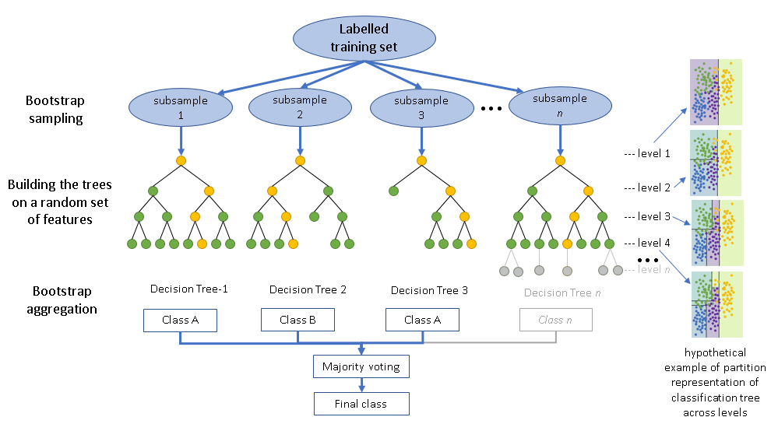
GROUP III: AI-BASED MODELS
Random Forest Classification Model – How it works

Slide 5
GROUP III: AI-BASED MODELS
Random Forest Hyperparameters
Hyperparameter tuning is about finding a set of optimal hyperparameter values which maximizes the model's performance, minimizes loss and produces better outputs.
n_estimators: This is the number of trees in the forest.
max_depth: The longest path between the root node and the leaf node.
min_sample_split: The minimum number of samples required to split an internal node: default = 2
bootstrap: Method for sampling data points (with or without replacement). Default = True
min_samples_leaf: Specifies the minimum number of samples that should be present in the leaf node after splitting a node. Default = 1
max_features: This is the number of features to consider when looking for the best split.

Slide 6
GROUP III: AI-BASED MODELS
Random Forest Classifier
Creation of RF_classification class from the superclass
Importing & splitting the dataset into train and test subsets according to user-defined test size.
Creation of Random forest classifier model
Training the model on the training data using user-defined parameters such as the number of trees, feature selection etc.
Testing the model on the test data as well as predictions using the training data
Display of results and plots: Accuracy scores, confusion matrix and feature importance

Slide 7
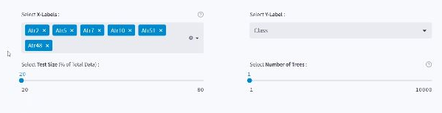
GROUP III: AI-BASED MODELS
Random Forest Classifier
USER INPUT
X-label(feature selection)
Portion of test data
Number of trees

Slide 8
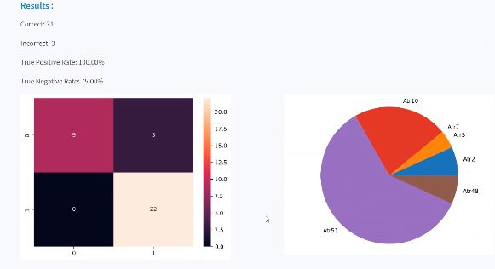
GROUP III: AI-BASED MODELS
Random Forest Classifier
OUTPUT
Accuracy on Test and Train data
Confusion Matrix
Feature importance chart

Slide 9
GROUP III: AI-BASED MODELS
Random Forest: Advantages
It overcomes the problem of overfitting by averaging or combining the results of different decision trees.
Random Forest algorithms maintain good accuracy even when a large proportion of the data is missing.
Random forests work well for a large range of data items than a single decision tree does.
It can be used for both classification and regression tasks.
It runs efficiently on large databases.

Slide 10
GROUP III: AI-BASED MODELS
Random Forest: Disadvantages
Construction of Random forests are much harder and time-consuming than decision trees.
Low interpretability: Random forest is a black box. It is difficult to understand how and why it came to a particular decision.
The process of creating hundreds or thousands of trees used by Random forest in making decision slows down the process, hence making it inefficient for real time forecasting.
Random forest may not get good results for small data or low-dimensional data (data with few features). Since the randomness becomes greatly reduced. Processing high-dimensional data and feature-missing data are the strengths of random forest.
Random forest may overfit for data with much noise.

